Slide 1

Audiance, Raise your hands if:
You are familiar with data science
You are working as Data Scientist/analyst
You know ML algorithms
Know difference b/w supervised and unsupervised
Know difference b/w structured and unstructured data
Want to learn and shift to data science

Slide 2

Data Pre-processing in python using scikit-learn library
Raj Shukla
My Ally
M.Tech (UoH)

Slide 3
Content
Feature Scaling (Any scale, say 1-100)
Feature Normaization (0-1)
Feature Standardization
Binarization
Label Encoding
One-Hot Encoding

Slide 4
Types of Attribute
Numeric
  Discrete
  Continuous
Categorical
  Nominal (Color of objects)
  Ordinal (Rank in class)

Slide 5
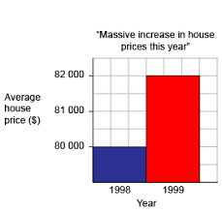
How many times Average house price increased in 1999

Slide 6
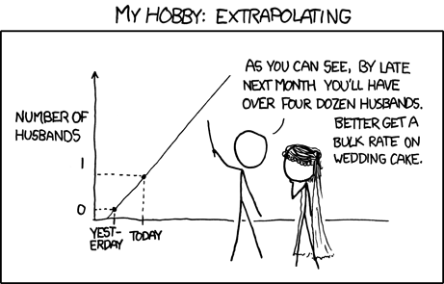
Stats and numbers
"There are three kinds of lies: lies, damned lies, and statistics." -Mark Twain

Slide 7
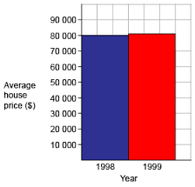
Really 3 times increase?

Slide 8

Feature Scaling
Feature scaling is the method to limit the range of variables so that they can be compared on common grounds.
It is performed on continuous variables.

Slide 9
Normalization
Normalization is the process of scaling individual samples to have unit norm.
L1 and l2 norms are usually used
L1 is absolute difference
L2 is euclidian distance

Slide 10
Feature Standardization
Standardization (or Z-score normalization) is the process where the features are rescaled with μ=0 and σ=1.
where μ is the mean (average) and σ is the standard deviation from the mean.
Z = (x-μ)/σ

Slide 11
Binarization
Many times we dont care how much, its only about wheather it present or not?
Binarization is the process of thresholding numerical features to get boolean values.
List = (-5,-2,3,6,1,-7,5,11,8,0,3,4)
Binarise list using threshold = 0
List = (0,0,1,1,1,0,1,1,1,0,1,1)

Slide 12
Label Encoding
Features such as Gender, Married, Dependents, Self_Employed and Education are categorical features, which have string values.
For example, Gender has two levels either Male or Female.
LabelEncoder encode labels with value between 0 and n_classes-1.

Slide 13
One-Hot Encoding
One-Hot Encoding transforms each categorical feature with n possible values into n binary features, with only one active.
For 4 variable, it will be 0001, 0010, 0100, 1000
Its fast, and used in widely.

Slide 14
Questions???
Thank you

